Slide 1
Chapter 12: Formal Organization

Slide 2
Key Points Addressed
A Definition of Formal Organizations
Perspectives on Formal Organizations
Burnout: A Negative Organizational Outcome
Social Work and Formal Organizations
Social Work Leadership in Formal Organizations
Culturally Sensitive Care Systems

Slide 3
A Definition of Formal Organizations
A collectivity of people with a high degree of formal structure, working together to meet common goals
Can differ in:
  Size
  Structure
  Culture
  Goals
  Functions

Slide 4
A Definition of Formal Organizations
Helps individuals meet their needs
Helps individuals fulfill goals
Nurtures individual development
Makes stressful demands
Thwarts goals
Inhibits holistic development
Constrains behavior

Slide 5
Perspectives on Formal Organizations
Contemporary Organizational Theories:
  Challenges rationality of formal organizations but image of the modern organization as a rational instrument of efficiency and predictability has lasting influence on theories
  Recognize some sort of relationship between organization and environment
  Challenged and raised questions about domination and oppression in organizational life
  Are influenced by the national culture of the theorists who developed them

Slide 6
Consider
Are organizational theories constructed according to worldview, tied up in culture, and do they vary from nation to nation?
How can social workers in the U.S. provide caring services in organizations that operate within a societal context that reveres the market?

Slide 7
Rational Perspective
Efficiency
and
Effectiveness:
  Meeting the organizations goals in the most efficient manner possible
Organizational Structures (i.e. job positions, salary scales, employee benefits, etc.)
Organizational Processes
(i.e. hiring and firing process; communication networks, etc.)

Slide 8
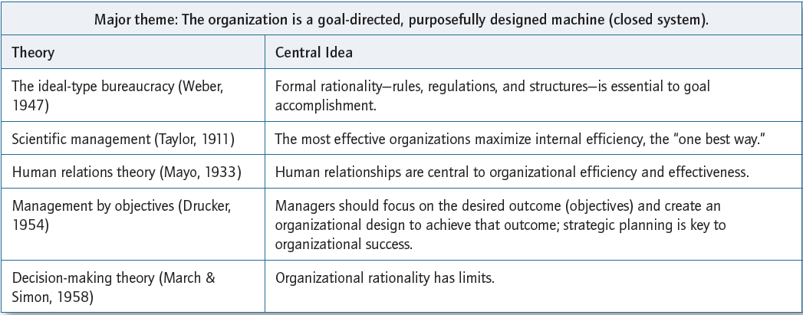
Rational Perspective Cont.

Slide 9
Consider:
Why is emphasis on best practices and evidence-based practice considered to be a derivative of scientific management?
Why are social service organizations better suited to Theory Y management of organizational development theory?
How was Theory X and Theory Y illustrated in Beacon Center?

Slide 10
Systems Perspective
Organizations are in constant interaction with its multiple environments – social, political, economic, cultural, technological – and must be able to adapt to environmental change
Organizations are composed of interrelated systems that must be integrated in order to achieve the organization’s goals and meet environmental demands
There are many ways to reach the same ends

Slide 11
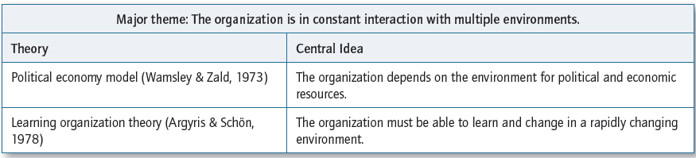
Systems Perspective Cont.

Slide 12
Consider
Which of the systems models helps social service organizations resolve such important issues as which clients to serve, which services to provide, how to organize service provision, and how to define staff and client roles? How so?
Which model highlights understanding services from the points of view of clients and other actors in the environment? How so?

Slide 13
Interactional/Interpretive Perspective
Organizations provide members with a sense of connection and meaning
Organizations reflect the worldview of the creators; they are social constructions of reality created by ongoing interactions and emerging relationships
Also focuses on:
  Process, rather than goals
  Flexibility, rather than control and reason
  Diversity of approaches, rather than one right way

Slide 14
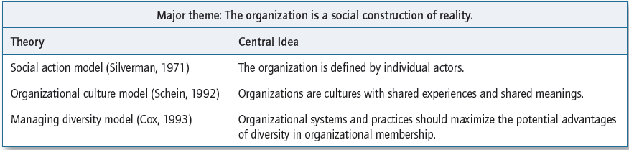
Interactional/Interpretive Perspective Cont.

Slide 15
Consider
What role would public administrators play in the discourse theory of public administration? Elaborate.
What interactional/interpretive perspective fosters the performance of multidisciplinary groups in human service organizations? How so?

Slide 16
Critical Perspective
Views organizations as instruments of exploitation and domination, where conflicting interests are decided in favor of the most powerful members
Ways organizations serve as “instruments of domination”
  Organizations create and continually reproduce patterns of social inequality through hierarchies
  Employees are exposed to work conditions that are hazardous to their health and welfare, work expectations interfere with personal health maintenance
  Employees experience mental health problems caused by job insecurity and globalizing economy

Slide 17
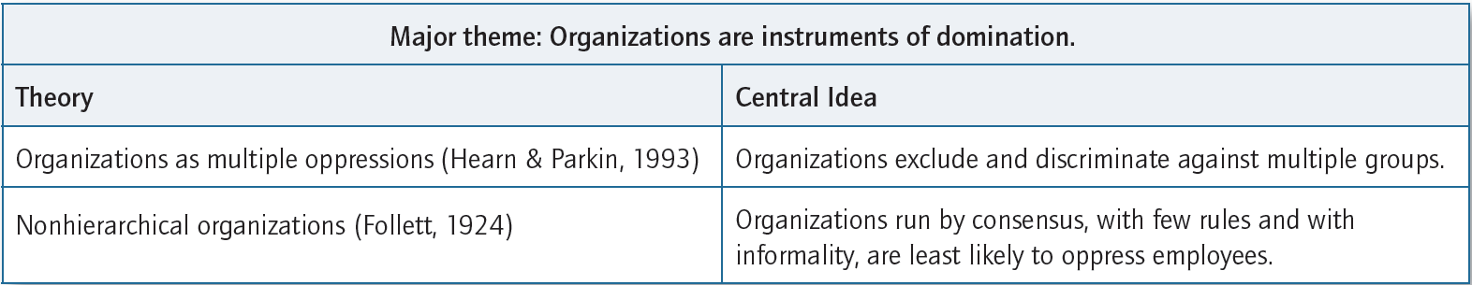
Critical Perspective Cont.

Slide 18
Consider:
What does the critical perspective tell us about client’s struggles within oppressive structures?
Which would best meet client need in social work profession: nonhierarchical organizations or hierarchical organizations?
Why is mainstream organizational theory a theory for the elite and not theory for the exploited?

Slide 19
Burnout: A Negative Organizational Outcome
Burnout – prolonged response to chronic emotional and interpersonal stressors on the job
The three dimensions of burnout:
  Exhaustion
  Cynicism
  Inefficacy
Study of burnout gives voice to individuals who are dominated or exploited

Slide 20
Burnout: A Negative
Organizational Outcome Cont.
Six dimensions of work life associated with burnout
  1. Workload
  2. Control
  3. Reward
  4. Community
  5. Fairness
  6. Values
Organizational factors play a bigger role in burnout than individual factors

Slide 21
Burnout: A Negative
Organizational Outcome Cont.
Social work is an occupation with above-average risk of burnout
Emotional labor – engagement, suppression, or evocation of the worker’s emotions necessary to get the job done
Compassion fatigue – reduced capacity for empathy caused by an overexposure to suffering

Slide 22
Consider
Why do social workers need to be attuned to symptoms of job-related burnout in their clients and in themselves?
What aspects of organizations increase/minimize burnout?
The research to date indicates:
  Organizational factors play a bigger role in burnout than individual factors
  Greater attention has been given to individual-oriented approaches to preventing burnout than to changing aspects of organizations
  Why might this be so?

Slide 23
Social Work and Formal Organizations
Organizations social workers are in:
  Host organizations
  Social work-oriented organizations
  Human service organizations
    Hybrid organizations
    Social entrepreneurial organizations
Another way to think about organizations:
  Public social service organizations
  Private social service organizations

Slide 24
Social Work and Organizations:
Questions about Privatization
What is the privatization of social services? Why is it important?
What is the research evidence about the for-profit social services regarding the promise to cut costs?
Will for-profit organizations, in search of profitable business opportunities, voluntarily serve the common good?
  Will they engage in advocacy and community building activities that are the hallmark of the social work profession and the history of nonprofit organizations?
  Will they deny service as a cost-cutting measure, particularly service to clients with the most entrenched problems?
  Will they have undue influence on social welfare policy in a way that protects their own interests?

Slide 25
Technology and Social Service Organizations
Information and communication technology (ICT) is an integral part of most social service organizations
Use of Internet and wireless-supported mental health interventions indicate positive outcomes but raise questions of confidentiality and access

Slide 26
Social Work Leadership in
Formal Organizations
Every social worker carries leadership responsibility in the organizations where they work
Leadership is “an attitude about responsibilities in an organization based on professional skills and a set of values that compel an individual to act”
Social workers act as:
  Assigned leaders in organizational positions that carry with them formal authority
  Emergent leaders with personal authority that is recognized by others regardless of position

Slide 27
Social Work Leadership in
Formal Organizations Cont.
In the contemporary globalized multicultural world, social workers must be able to:
  Live with change and flux
  Live with ambiguity
  Recognize multiple perspectives on situations
Must know how to:
  Maneuver bureaucracies and complex systems
  Manage diversity
  Recognize and struggle against the multiple oppressions in our own and other organizations

Slide 28
Culturally Sensitive Care Systems
Individual efforts need to envision cultural sensitivity and encode it into the fabric of social service organizations
Leadership skills that can help build culturally sensitive workplaces:
  Building community
  Communicating orally and in writing
  Performing comprehensive analysis of social, political, and cultural events

Slide 29
Culturally Sensitive Care Systems Cont.
Guidelines for developing culturally sensitive system of care
  Location and name are accessible to the targeted population
  Agency website is user-friendly for diverse populations
  Diversity in the board of directors, administrators, and professional and nonprofessional staff similar to the targeted population
  Ongoing training and communication about diversity issues and multicultural communication
  Create climate where people can recover from multicultural miscommunications

Slide 30
Culturally Sensitive Care Systems Cont.
  Ongoing efforts to involve minority staff members in information networks and decision-making processes
  Staff engaged in learning about the community, its norms, values, formal and informal resources, the ways in which it is changing
  An understanding of and preferences for care giving and care receiving
  Staff engaged in active outreach, attend local functions, give talks in community organizations
  Staff maintains relationships with other organizations that serve the same population

